Slide 1
OPER 623 Heuristic Search Methods
Lesson 1
What, Why, and When of Heuristic Optimization

Slide 2
Outline
Who am I?
Syllabus
What is a Heuristic?
Why use Heuristics?
When do we use Heuristics?

Slide 3
Outline
Who am I?
Syllabus
What is a Heuristic?
Why use Heuristics?
When do we use Heuristics?

Slide 4
Who am I?
Retired Lt Col (15A)
Assignment history
Education History
In my 5th year as a professor at AFIT
Teach and Study Optimization, Heuristics and Machine Learning
Maybe not in that order

Slide 5
Outline
Who am I?
Syllabus
What is a Heuristic?
Why use Heuristics?
When do we use Heuristics?

Slide 6
Syllabus
Blend of “theory” and practice
Group Work (40%):
Project (30%)
Teacher for a day (10%)
Individual Work (60%):
Homework (30%)
Exam 1 (15%)
Exam 2 (15%)

Slide 7
Syllabus Project
Given a problem - The Traveling Salesman Problem (TSP)
Implement a method covered in class
May not just use code provided via class lab
May recycle code from labs with enhancements and modifications
Develop and implement a novel nature inspired method
Solve multiple instances of TSP using both methods
Write up a journal style article explaining your method and comparing it versus existing method
Develop a presentation summarizing your research and present it to class

Slide 8
Syllabus Teacher for a day
Well okay more like a teacher for 20 minutes…
Research a (Meta)heuristic method not covered in class
Present it to the class
Cover the problem it’s applied to
An overview of method
Present flowchart/pseudo code for method
An overview of tunable method parameters
Demonstration/example of your method
Results

Slide 9
Syllabus Independent Work
6 homework Assignments
Mix of theory and coding
2 Take home exams
1 as a midterm
1 as a “final”

Slide 10
Outline
Who am I?
Syllabus
What is a Heuristic?
Why use Heuristics?
When do we use Heuristics?

Slide 11



What is a Heuristic? Background - Operations Research
Operations Research (OR) is all about problem solving and insight applied to real-world problems. The art of OR is the translation of a real-world problem into some mathematical model form, solving that mathematical instantiation of the problem, and then translating those results from the model solution back to the real-world application.
Muller-Merbach, Heiner. “Heuristics and their design: a survey,” European Journal of Operational Research, Vol 8, No 1, pp: 1-23.

Slide 12
What is a Heuristic? Background – ‘Problem’ Levels
Level 1 – Messes
Where OR begins, unstructured problems, level at which the decision is needed.
Level 2 – Problems
Decision Maker/analyst individual abstraction of the ‘mess’, if formulated, is done in a very general manner.
Level 3 – Problem Statements
An explicit statement of the problem, perhaps in terms of relationships, systems engineering, etc
Level 4 – Mathematical Formulations
A formal mathematical representation of the problem, something that can be tackled by an algorithm
Muller-Merbach, Heiner. “Heuristics and their design: a survey,” European Journal of Operational Research, Vol 8, No 1, pp: 1-23.

Slide 13
What is a Heuristic? Background – Mathematical Problems
In the field of Ops Research the word ‘problem’ has a more specific meaning
For our purposes a problem can be thought of as a specific type of object… like a “chair” -- it contains general characteristics applicable to certain decision situations.
Example: The problem of scheduling packages for delivery order is similar to the problem of scheduling jobs in a local frame shop, but not very similar to determining which programs to fund given a limited budget. (Just as a desk chair is similar to a classroom chair, but not very similar to a car.)

Slide 14
What is a Heuristic? Background – Problem Instances
An instance of a problem is defined by all the input parameters needed to compute a solution to that instance. (Limits “chairs” down to that one particular chair)
What might these inputs be?
The parameters in the mathematical formulation
A problem class is a collection of instances of like mathematical form but differing in size and the values of numerical constants in the problem form. (The set of all classroom chairs)

Slide 15
Families of Problems
Solution Techniques: Dynamic Programming
Branch and Bound
Heuristics
Integer Programming Problems
Network Flow Problems
Solution Techniques: Epsilon Constrained
Weighted Sums
Heuristics
Solution Techniques: Dynamic Programming
Heuristics
Multiple Objective
Problems
Linear Programming
Problems
Non-Linear Programming
Problems
Solution Techniques: Simplex Interior Point
Heuristics
Solution Techniques: Steepest Ascent
Heuristics

Slide 16
What is a Heuristic? Background – Algorithms
An algorithm is a well-defined
sequence of steps designed to accomplish some goal, or
computational procedure that transforms inputs into outputs

Slide 17
Algorithm Family Tree
Algorithms
Iterative
algorithms
Direct algorithms
(non-iterative)
Converging
Algorithms
Algorithms without
proven convergence
(Heuristics)
Approximation
algorithms
Finite
algorithms
Path structure
Algorithms
(e.g., Simplex, Steepest Ascent)
Tree structure
Algorithms
(e.g., Branch and bound, dynamic )
Muller-Merbach, Heiner. “Heuristics and their design: a survey,” European Journal of Operational Research, Vol 8, No 1, pp: 1-23.

Slide 18
What is a Heuristic? Background - Algorithms
The solution of problem instances will vary in terms of computational effort due to
problem type
problem instance features
algorithm employed
We want algorithms that are generally efficient in terms of
solution quality
computer resource requirements (memory)
computer effort expended

Slide 19
What is a Heuristic? Definition
“Rule of Thumb”
“An interactive algorithm which does not converge toward the solution of a problem” – Muller-Merbach
“A technique which seeks good (i.e., near optimal) solutions at a reasonable computational cost without being able to guarantee either feasibility or optimality, or even, in many cases, to state how close to optimality a particular feasible solution is.” – Reeves
Reeves, Colin R. (ed) Modern Heuristic Techniques for Combinatorial Problems, MacGraw-Hill, Inc, 1993.

Slide 20
Outline
Who am I?
Syllabus
What is a Heuristic?
Why use Heuristics?
When do we use Heuristics?

Slide 21
Why use heuristics? Intro
If (converging) algorithms give us, at best, exact optimal solutions or, at worst, precise mathematically bounded estimates why would I ever use a heuristic that not only may fail to give me an optimal solution but cannot even tell me if it did fail, or how badly it failed?

Slide 22
Why use heuristics? Summary
Less restrictive assumptions
Understandable methods
Use within optimization routines
Only method available

Slide 23
Why use heuristics? 1. Algorithm Assumptions
Converging algorithms (Simplex etc.) buy their mathematical convergence proofs at the expense of strict assumptions
When these assumptions are met the algorithms work
When they are not met the algorithms may fail, spectacularly (try simplex on a nonlinear problem!)
Heuristics have much more forgiving and general assumptions

Slide 24
Why use heuristics? 1. Accurate Modeling
As a result of these strict requirements models of “messes” are often over simplified to force the resulting mathematical model to fit the algorithm requirements.
Garbage-in Garbage-out
Heuristic assumptions are easier to meet, enabling the ORSA to model the mess more accurately
“…should we prefer an exact solution of an approximate model, or an approximate solution of an exact model?” - Reeves

Slide 25
Why use heuristics? 2. Sellability
Senior leaders may be very loath to implement the results of an algorithm they cannot understand
Heuristics are generally easily understood, which enables better buy-in
Our job is to improve processes, use all the tools in your tool-kit towards that aim.

Slide 26
Why use heuristics? 3. Use within converging algorithms
Heuristic solutions can provide good initial solutions to seed iterative converging algorithms
Heuristics can provide bounds for branch and bound/ branch and cut methods

Slide 27
Why use heuristics? 4. ‘Hard’ , Large, and Ugly Problems
Some problem classes exist that are just ‘hard’.
We will make this term more precise soon
It may be impossible to solve these problems to optimality, or it would take untenable amount of time
Some problem instances are just really, really large
Modern algorithms can solve very large problems but they often do so to a fixed error
Non-linear, non-convex problems with multiple local minima are ugly, and most algorithms get ‘trapped’ by local minima

Slide 28
Why use heuristics? 4. One set of hard problems - Combinatorial
Subset of Mathematical Programming
Decision variables are discrete-valued (typically binary)
Seek the best combination of values out of a finite set of combinations
Often represented via networks/graphs
“Combinatorial explosion”
Examples
Traveling Salesman Problem (TSP) and other routing variants
Knapsack Problem and its variants

Slide 29
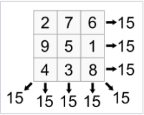
Why use heuristics? 4. Combinatorial Explosion Example
Consider the ‘Magic Square” problem
Given a 3x3 table: Fill 9 cells with integers 1…9 so the sum of each row, each column and each diagonal are equal
For 3x3 we have 9 places to put first number, 8 places to put second number, 7 places to put third number… 9*8*7 …*1 = 9! = 362,880 possible arrangements
For 5x5 we have 25! = 1.55 x 10²⁵ which takes a computer solving 10 trillion operations a second 49,000 years to sort thru
Levitin, A and Levitin M. “Algorithmic puzzles” Oxford University Press 2011

Slide 30
Outline
Who am I?
Syllabus
What is a Heuristic?
Why use Heuristics?
When do we use Heuristics?

Slide 31
When should we use heuristics? To rectify any of above problems!
Inexact or limited data in the problem
Data errors are known to exist, so even an exact solution to a great model is merely an approximation
Simplified model
If the accuracy of the model is already reduced, sub-optimal answers are fine
Unavailability of exact method(s) -- variety of reasons
Lack of access to a computer code ($)
Poor implementation of the code
Limited computing resources; can’t run the codes if available
Heuristic might even outperform the optimization code!
Zanakis, S. H. and J. R. Evans. “Heuristic Optimization: Why, When, and How to Use It,” Interfaces, Vol 11, No 5, October 1981: pp: 84-91.

Slide 32
When should we use heuristics?
Improve optimizer performance
provide improved starting point
provide lower and/or upper bounds for problem
Requirement for multiple runs of the code (speed)
Need for real-time results -- in such a case, the system may forgo exact results to obtain known and consistent processing times
The 80% solution is good enough (80/20 rule)
Zanakis, S. H. and J. R. Evans. “Heuristic Optimization: Why, When, and How to Use It,” Interfaces, Vol 11, No 5, October 1981: pp: 84-91.

Slide 33
When should we use heuristics?
Heuristics are simple to understand
some are based on expert opinion or historical practice
understanding and comprehension of the technique increases confidence and is likely to facilitate future changes and maintenance
(facilitates tailoring to problem)
Learning device -- gain additional insight into the problem
Other resource limitations -- budget, time, etc.
Zanakis, S. H. and J. R. Evans. “Heuristic Optimization: Why, When, and How to Use It,” Interfaces, Vol 11, No 5, October 1981: pp: 84-91.
Notes:
When might we want to employ heuristics? Yet another reason gets back to the idea of solving real problems versus approximate problems
Certain mathematical structures are amenable to regular, or classical, optimization techniques. Other mathematical structures are not.
We often make very strong problem assumptions to force mathematical structure when in reality these assumptions may not hold.
example:
Consider an “either-or” constraint.
In integer programming X ≤ 1 - Y
As nonlinear XY = 0
Consider this mathematical formulation issue is more depth.
Recall the OR process, moving from messes through to mathematical models. We apply algorithms to these math models. But, these can be too restrictive, such as pure integer or mixed-integer linear programs.
If we relax the formulation restriction, we free up our ability to accurately model reality. However, the more complex the formulation, the less efficient the solution algorithm in converging to optimality.
Example: non-linear programming codes
Further, the more complex the formulation, the less ability we have to solve the problem. Once again, strong assumptions are placed on these complex formulations to ensure our codes and computers can handle the problem
Example: Optimal Marginal Evaluator (OME) -- a large dynamic programming-based campaign model required composite weapons to ensure reasonable problem solution times.
The stronger the assumptions, the larger the difference between the mathematical representation and the true nature of the real problem. This holds regardless of your choice of optimization approach (linear, non-linear).
The ideal situation: an accurate representation of reality and an algorithm robust to such representations.
This is where the real popularity of heuristics has begun to emerge. Heuristics improve performance with respect to robust techniques applied to real problems.

Slide 34
When should we use heuristics?
Certain mathematical structures are amenable to regular, or classical, optimization techniques other mathematical structures are not.
We often make very strong problem assumptions to force mathematical structure when in reality these assumptions may not hold.
The stronger the assumptions, the larger the difference between the mathematical representation and the true nature of the real problem. This holds regardless of your choice of optimization approach (linear, non-linear).
The exact optimal solution to an inexact mathematical model may not even be a feasible solution to the real problem.

Slide 35
When should we use heuristics?
If we relax the formulation restriction, we free up our ability to accurately model reality.
The ideal situation: an accurate representation of reality and an efficient algorithm robust to such representations.
This is where the real popularity of heuristics has begun to emerge. Heuristics improve performance with respect to robust techniques applied to real problems.

Slide 36
When should we use heuristics?
Despite the recent increased popularity, heuristics were not always (and still not) well-received in optimization community.
“an admission of defeat” in getting a tractable form
“quick and dirty” type of solution technique
not really mathematical -- for those who prefer rigor
This was me
not elegant -- optimization has proofs, heuristics guidelines
Also was me
glorified explicit enumeration -- since really searching the solution space

Slide 37
“Skeptical – and sensibly skeptical – managements have come to see that, even if not all the blue-sky claims for the new approaches have been backed by solid fact, there is a large core of valid technique and application. These tools have produced tangible results in a substantial number of demonstration installations, and the question is less and less “Are they here to stay?” and more and more “How and where can we use them effectively?”
- Simon and Newell, Operations Research, Vol 6, Num 1, 1958, discussing exotic techniques such as LP, queuing theory, game theory, dynamic programming, and others.

Slide 38
Summary
Messes to Mathematical Formulations
Problems
Combinatorial Optimization
Algorithms
Complexity Analysis
What is a Heuristic?
Why use Heuristics?
When do we use Heuristics?

Slide 39
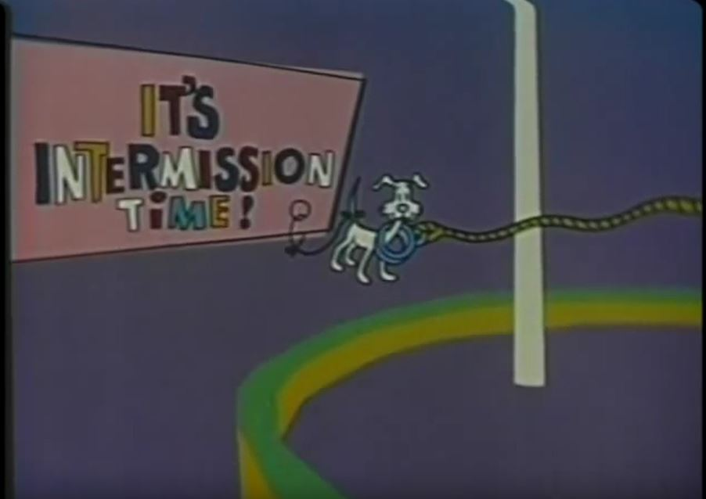
Break

Slide 40
8 Queens Puzzle
Consider an 8 by 8 chess board.
Object is to place 8 queens on the board such that no queens are attacking each other
No two queens in any one row.
No two queens in any one columns.
No two queens in any one diagonal.
Try to solve the puzzle.
More important: How are you trying to solve the puzzle
Start with an empty board and add pieces?
Or start with all 8 pieces but some are attacking each other, then move?
Do you change solution methodologies as you progress?
There are 92 feasible solutions, if you get one, try for another.

